Slide 1
Face counting for generative AI
Name : p.rithanya
Reg no. : 71222110417
Dept : B.E(cse) &3rd year
College : park College of engineering and technology

Slide 2
Agenda
Problem Statement
Project Overview
End Users
Our Solution and Proposition
Key Features
Modelling Approach
Results and Evaluation
Conclusion

Slide 3
Problem statement
The problem statement for face counting in generating AI involves developing algorithms and models capable of accurately detecting and counting the number of human faces present in images or videos. This task is crucial for various applications, including surveillance, security, crowd management, and social media analytics. The objective is to create robust and efficient face detection and counting systems that can handle different scenarios, variations in lighting conditions, occlusions, and facial expressions while maintaining high accuracy and speed.
Notes:
The problem statement for face counting in generating AI involves developing algorithms and models capable of accurately detecting and counting the number of human faces present in images or videos. This task is crucial for various applications, including surveillance, security, crowd management, and social media analytics. The objective is to create robust and efficient face detection and counting systems that can handle different scenarios, variations in lighting conditions, occlusions, and facial expressions while maintaining high accuracy and speed.

Slide 4
Who Are the end users ?
Retailers
Event organizers
Transportation authorities
Marketing and advertising companies
Security And law enforcement agencies

Slide 5
Our solutions and its value preposition
There are various approaches to this, including using computer vision techniques like facial detection and recognition algorithms.
Our proposition could involve leveraging deep learning models trained on large datasets to accurately detect and count faces in images or video streams.
This would require robust algorithms capable of handling various lighting conditions, angles, and occlusions. Additionally, real-time processing and scalability would be important considerations for practical applications.

Slide 6
The “WoW” in our solution
The advancements in AI-driven face counting solutions have indeed been remarkable. The ability of these systems to accurately detect and count faces in various environments and conditions showcases the power of machine learning and computer vision technologies.

Slide 7
Modelling
Data Collection: Gather a large dataset of images containing faces. This dataset should be diverse in terms of lighting conditions, angles, facial expressions, and demographics to ensure the model learns robust features.
Annotation: Annotate the dataset to label the number of faces present in each image. This step is crucial for supervised learning, where the model learns from labeled examples.
Preprocessing: Preprocess the images to standardize their size, format, and quality. This step may also involve data augmentation techniques to increase the variability of the dataset.

Slide 8
4.Model Selection: Choose an appropriate model architecture for face counting. This could be a convolutional neural network (CNN) or a more advanced architecture like a Region-based Convolutional Neural Network (R-CNN) or a Fully Convolutional Network (FCN
5.Training: Train the selected model on the annotated dataset. During training, the model learns to predict the number of faces in an image based on its features.

Slide 9
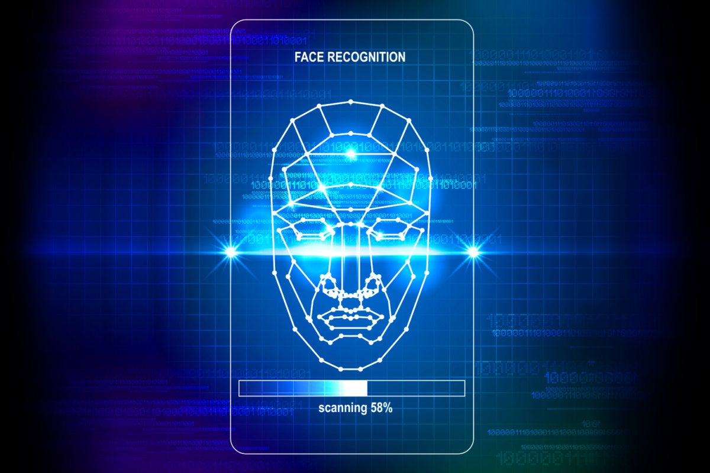
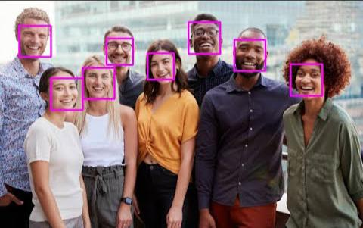
Results

Slide 10
Conclusion
The conclusion regarding face counting in AI generation is that it serves as a crucial aspect for various applications such as facial recognition, emotion detection, and demographic analysis. By accurately counting faces, AI systems can enhance their capabilities in understanding and interacting with human beings, leading to advancements in fields like security, marketing, and healthcare. However, ethical considerations regarding privacy, bias, and consent must be carefully addressed in the development and deployment of such technologies.

